Slide 1
Steering Meeting 5
Steering Meeting

Slide 2
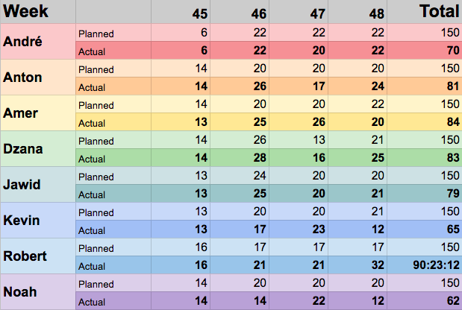
Time tracking for week 48

Slide 3
Previous Week (W4)
Closed
_Implementation_ | _Design_ | _Unlabeled_
5 issues 32,5 hours | 7 issues 13,5 hours | 1 issue 2 hours
Notes:
As of 2017-12-02 14:14:40
Compared to the presentation last week the total hour count isn’t that high.
This has to do with week 3 having these large tasks:
Environment Configuration [37/40]
Create Project Plan Presentation [21/20]
Admin creates/edits/removes new swimlane [20/20]
Admin creates/edits/removes new category [20/20]
While the largest (looking at hours) task week 4 was:
Research how to handle drop event with internal API [11/14]
The other tasks are 1-3 hours per task. (hours invested, not hours evaluated)
This decrease in presented hours partially has to do with the fact that we worked on the design description document.
We did the work, but there aren't many issues about it.
That’s at least my evaluation.
There’s also tasks that are still open that are big, but also aren’t finished:
Research drag 'n drop functionality [0/20]
Jawid has worked on it, but as it’s not closed it’s not counted. (and the “hours invested” is still at 0)
I also don’t know if I should count issues that are still open, as there’s this one:
Enable logging in for local user [4/7]
4 hours have been invested into it according to the title, but it’s still open.
That’s the only one that has a non-zero value there.

Slide 4
Previous Week
Researched how we will implement drag and drop
Researched how we will implement internal API calls
Got access to TeamForge and set up a TeamForge server
Finished the Design description document
Implementation of GUI Design (Mostly CSS styling)
Implementation of login functionality (only local user for now)
Started preparing the Design Presentation

Slide 5
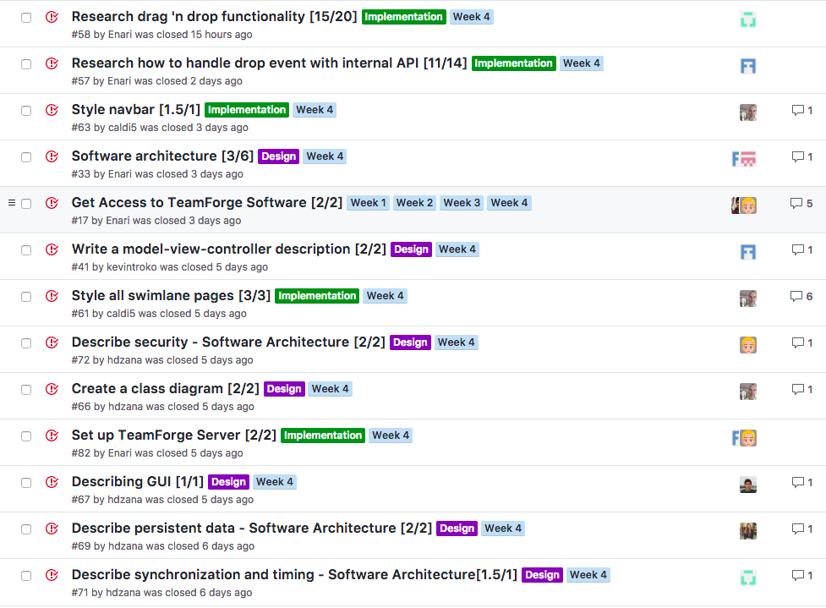
Previous Week
Notes:
We could show images of the closed tasks here.
Still waiting until tomorrow to see if some more stuff gets closed.
There were some things opened on friday in the week 4 milestone.
Namely:
Create kanban card - GUI [0/6]
Update Category table with ParentCategory. Update migration. [0/1.5]
Not sure if this was done in error, or if it was intentional.

Slide 6
Previous Week
Notes:
We could show images of the closed tasks here.
Still waiting until tomorrow to see if some more stuff gets closed.
There were some things opened on friday in the week 4 milestone.
Namely:
Create kanban card - GUI [0/6]
Update Category table with ParentCategory. Update migration. [0/1.5]
Not sure if this was done in error, or if it was intentional.

Slide 7
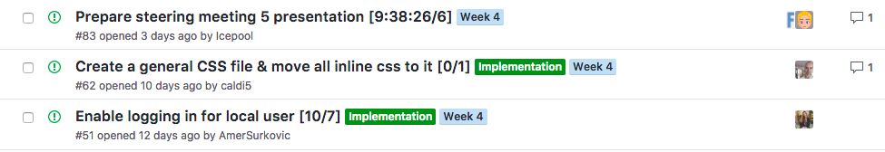
Tasks still open from previous week

Slide 8
Obstacle and Issues
We have different backgrounds, and different ways of doing things
Created a more detailed design
Deadlines coming up and time constraints
Helping each others, splitting tasks into smaller tasks.

Slide 9
Tasks moved from previous week
Create a static HTML board
Create an error partial
Create model & migration for kanban card
Create an admin filter dashboard
Update Category table with ParentCategory. Update migration
Notes:
Reason:
Design document,
low priority (error partial)
unmet dependencies (category table)
got access to teamforge, which resulted in reprioritization
poor planning

Slide 10
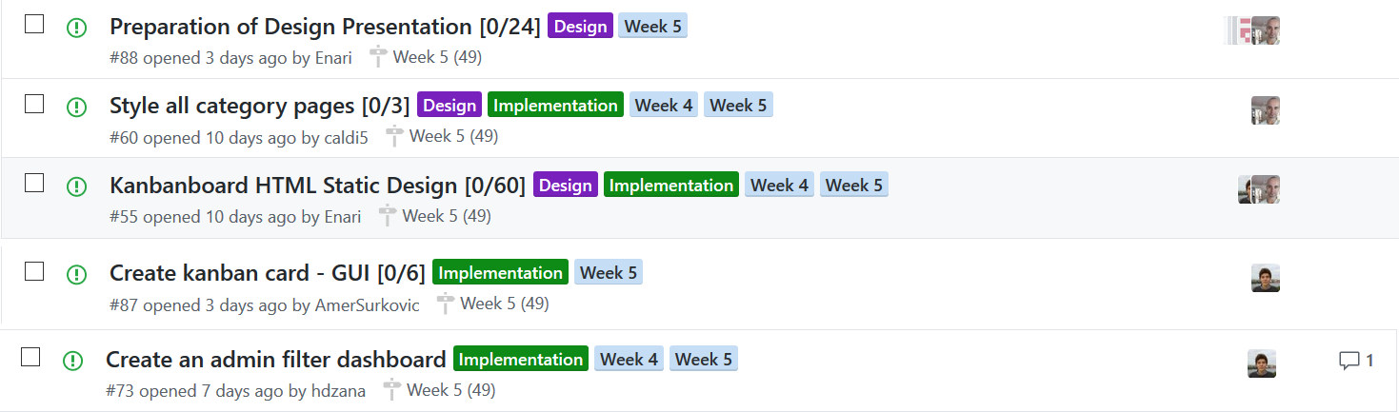
This Week
Frontend - Styling & Markup

Slide 11
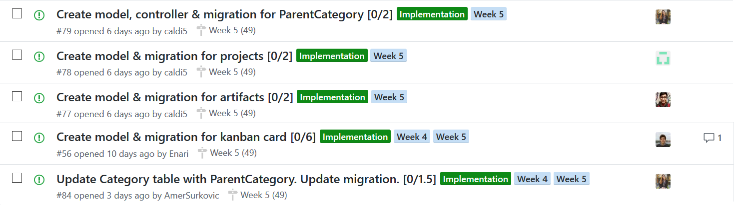
This Week
Backend - DB interaction & structure

Slide 12
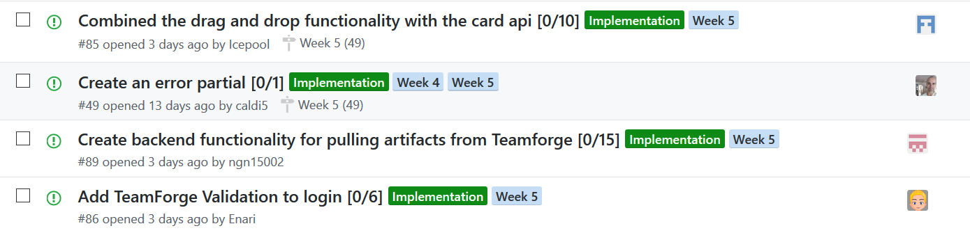
This Week
Backend - TeamForge & Misc.

Slide 13
This Week
Separation of tasks by type
_Implementation_ | _Design_ | _Implementation_ & _Design_
11 tasks 51,5 hours | 1 task 24 hours | 2 tasks 63 hours

Slide 14
Questions
Questions regarding feedback of class diagram

Slide 15
Questions for us?

